Slide 1
Forecasting Volatility
In Stock Market
DATASCI 207 Final Project, March 27, 2026
Sid Sridhar – siddharthen_sridhar@berkeley.edu
Diogo Viveiros – diogoviveiros@berkeley.edu
Ronald Ho – ronald.ho@berkeley.edu
Vinit S. Bhatt – vbhatt@berkeley.edu

Slide 2
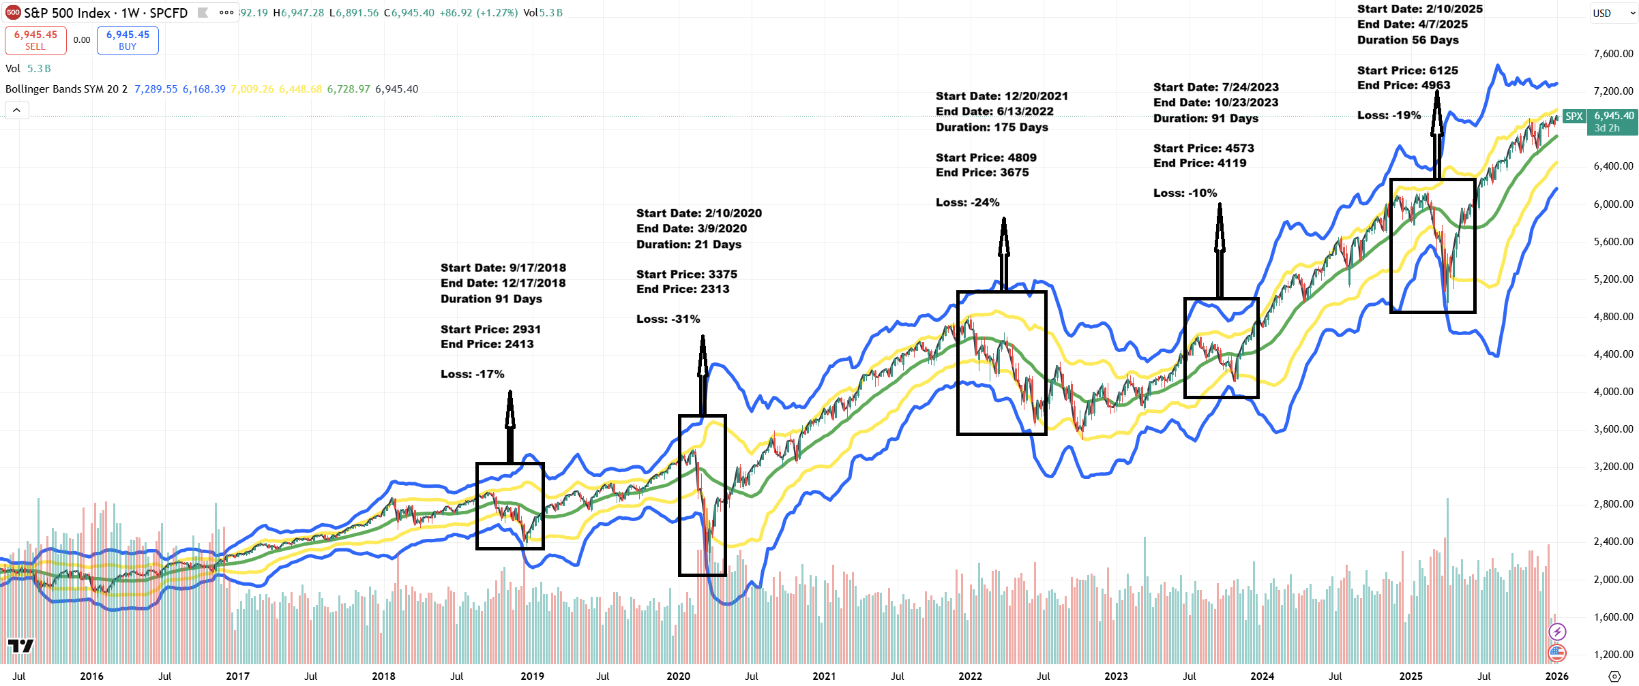
Project: Forecasting Volatility In Stock Market
What is Volatility?
S&P 500 chart highlighting major drawdowns and changing volatility regimes.
DATASCI 207 · Final Project: Forecasting Volatility In Stock Market · March 2026
Notes:
Project description summarized from the team project proposal and milestone report. [Sources] - Project Proposal PDF (uploaded in this chat) - Project Milestone Report PDF (uploaded in this chat) [/Sources]

Slide 3
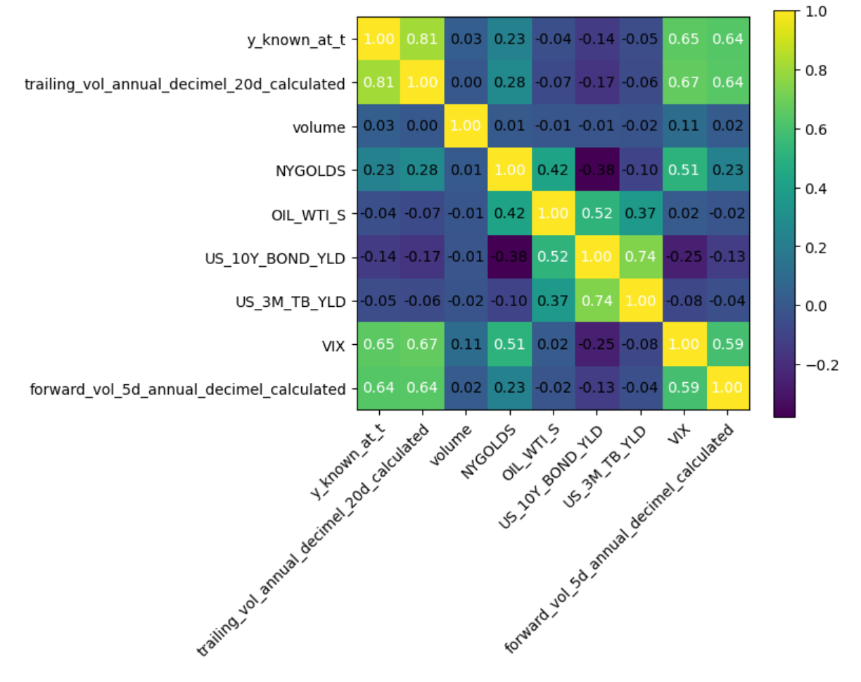
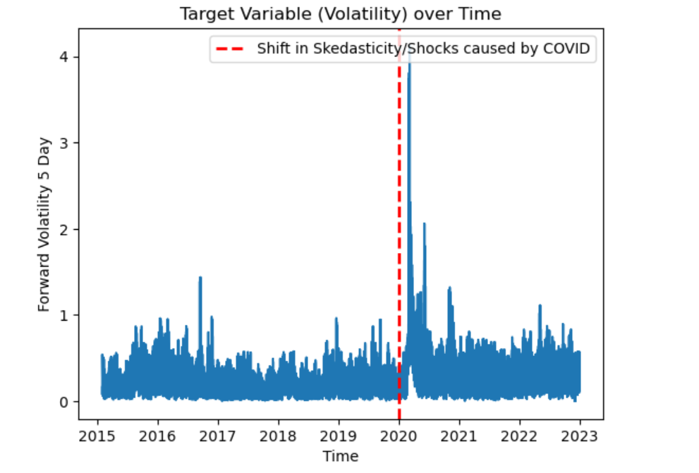
EDA
Time Series Data is Tricky
The Problem:
Features might be correlated, but with a lag of some days. Pearson correlation is impractical. Need models that address this.
Time Series fails Linear Assumptions, making most traditional models impractical. The underlying data is inherently noisy and prone to shocks
DATASCI 207 · Final Project: Forecasting Volatility In Stock Market · March 2026
Notes:
Project description summarized from the team project proposal and milestone report. [Sources] - Project Proposal PDF (uploaded in this chat) - Project Milestone Report PDF (uploaded in this chat) [/Sources]

Slide 4
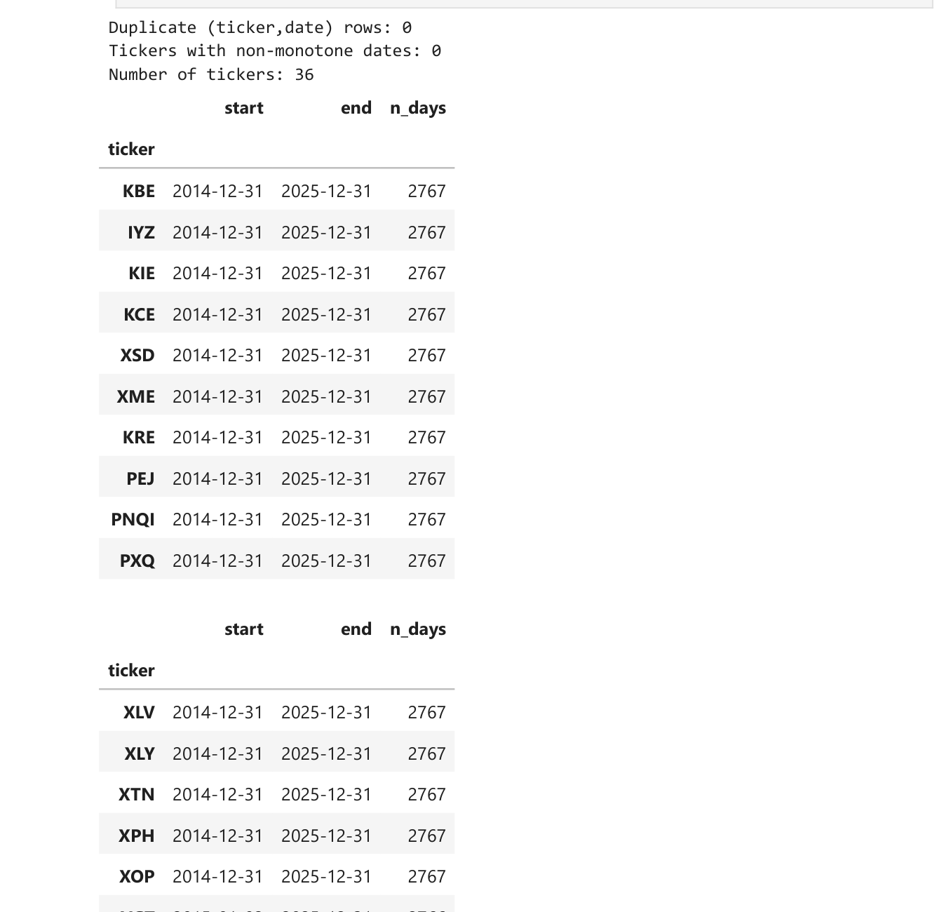
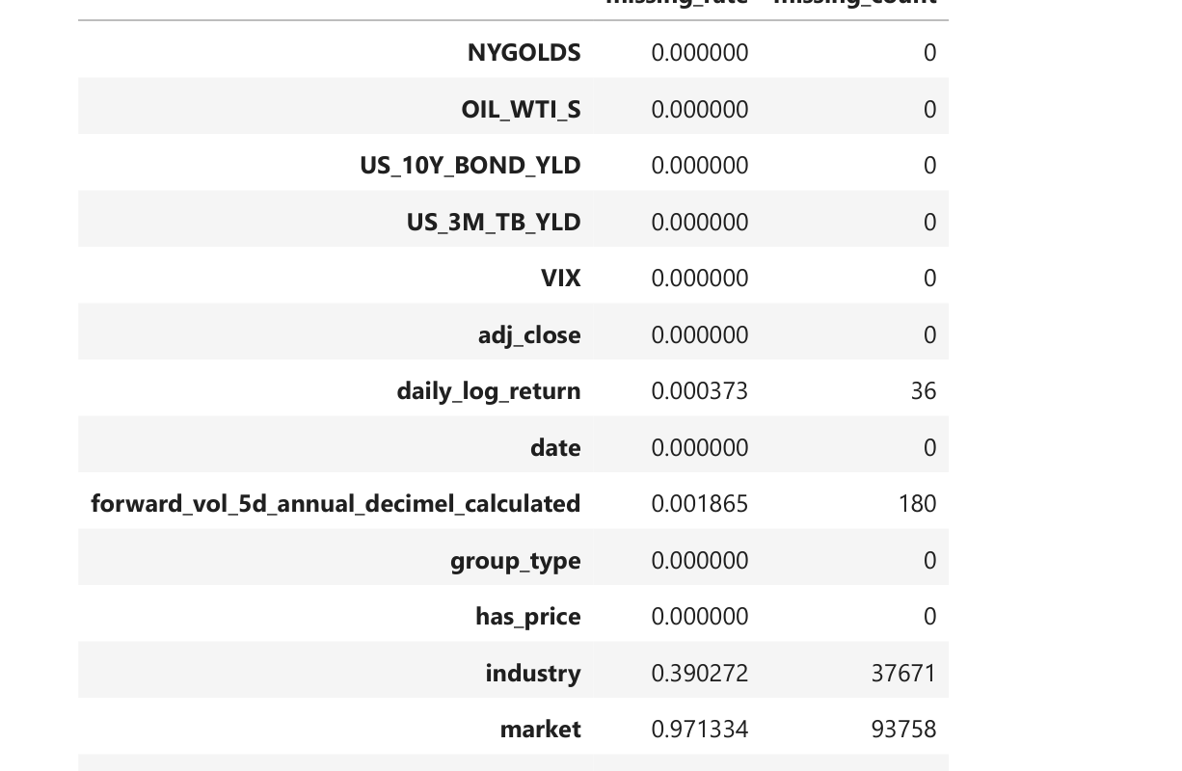
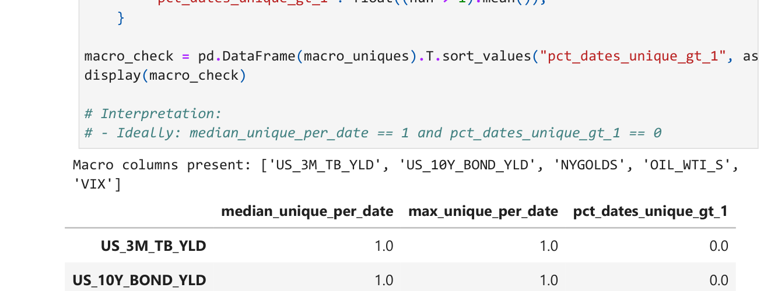
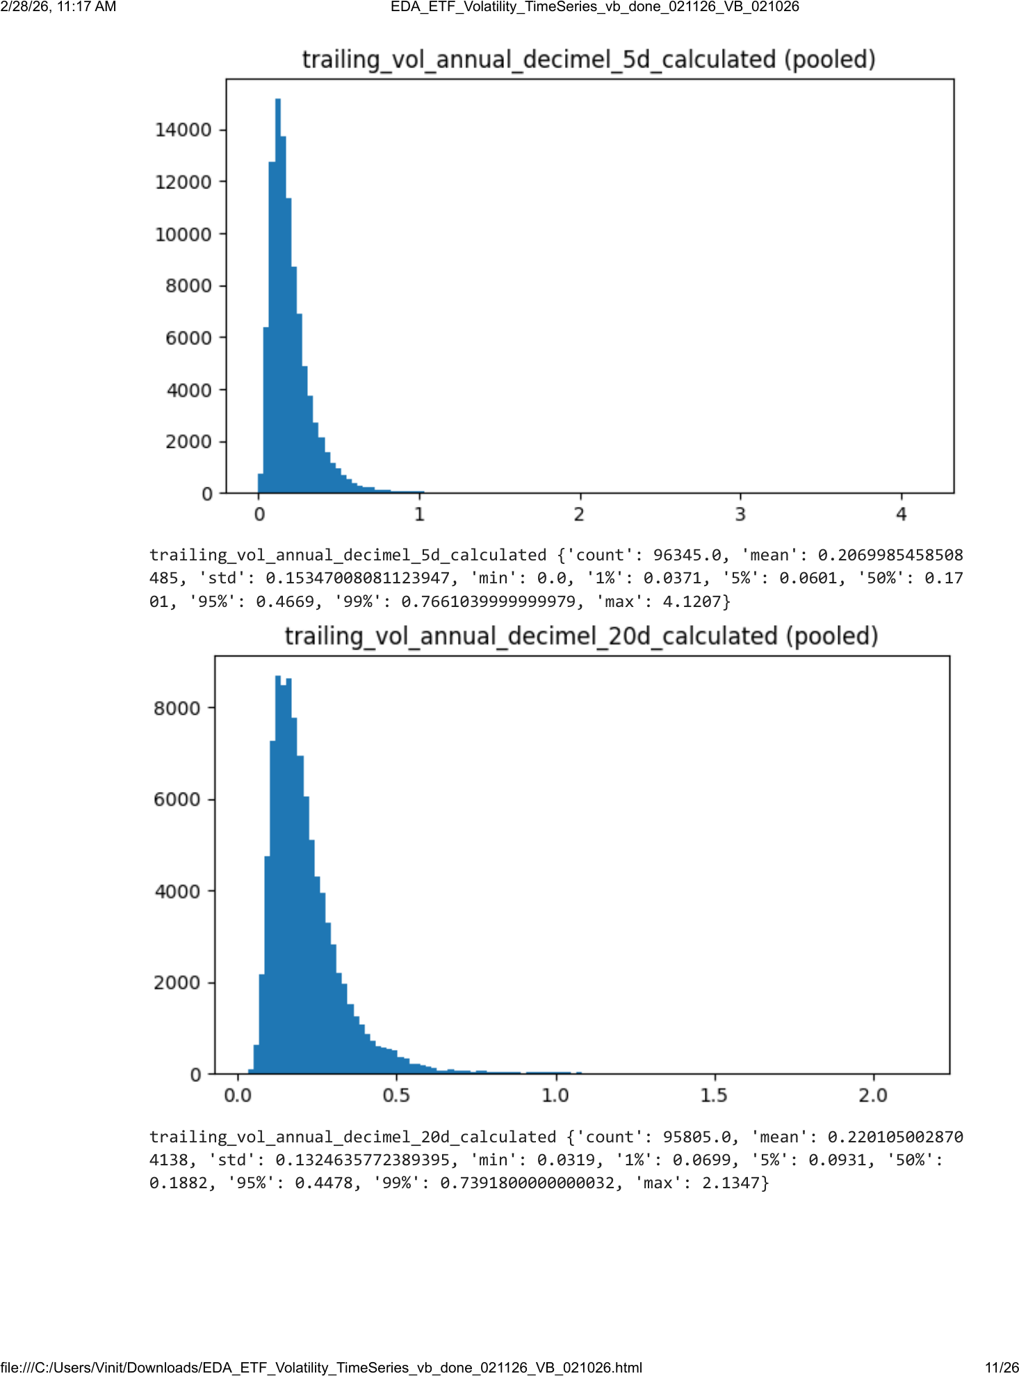
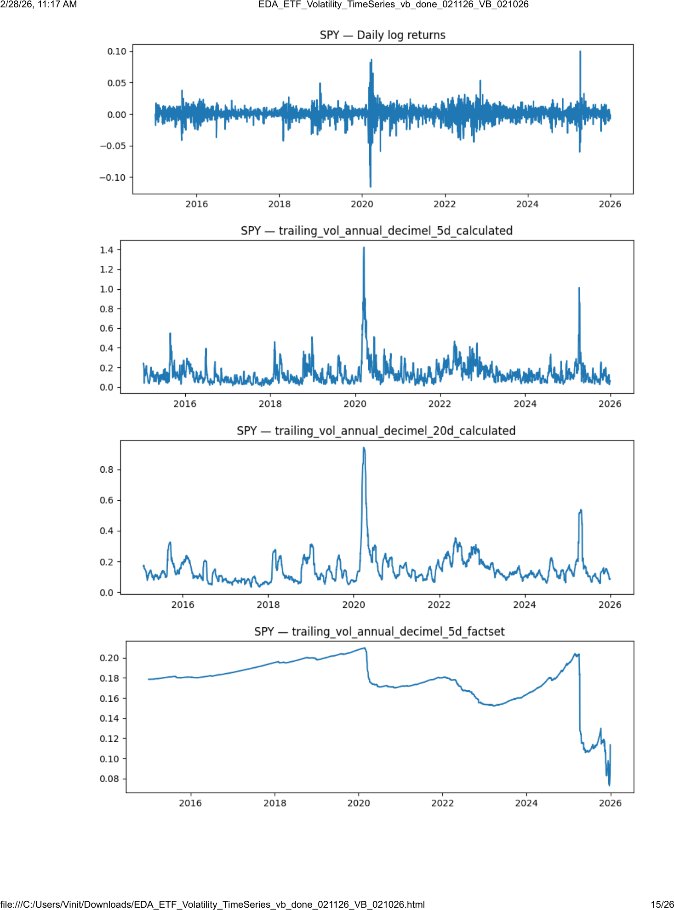
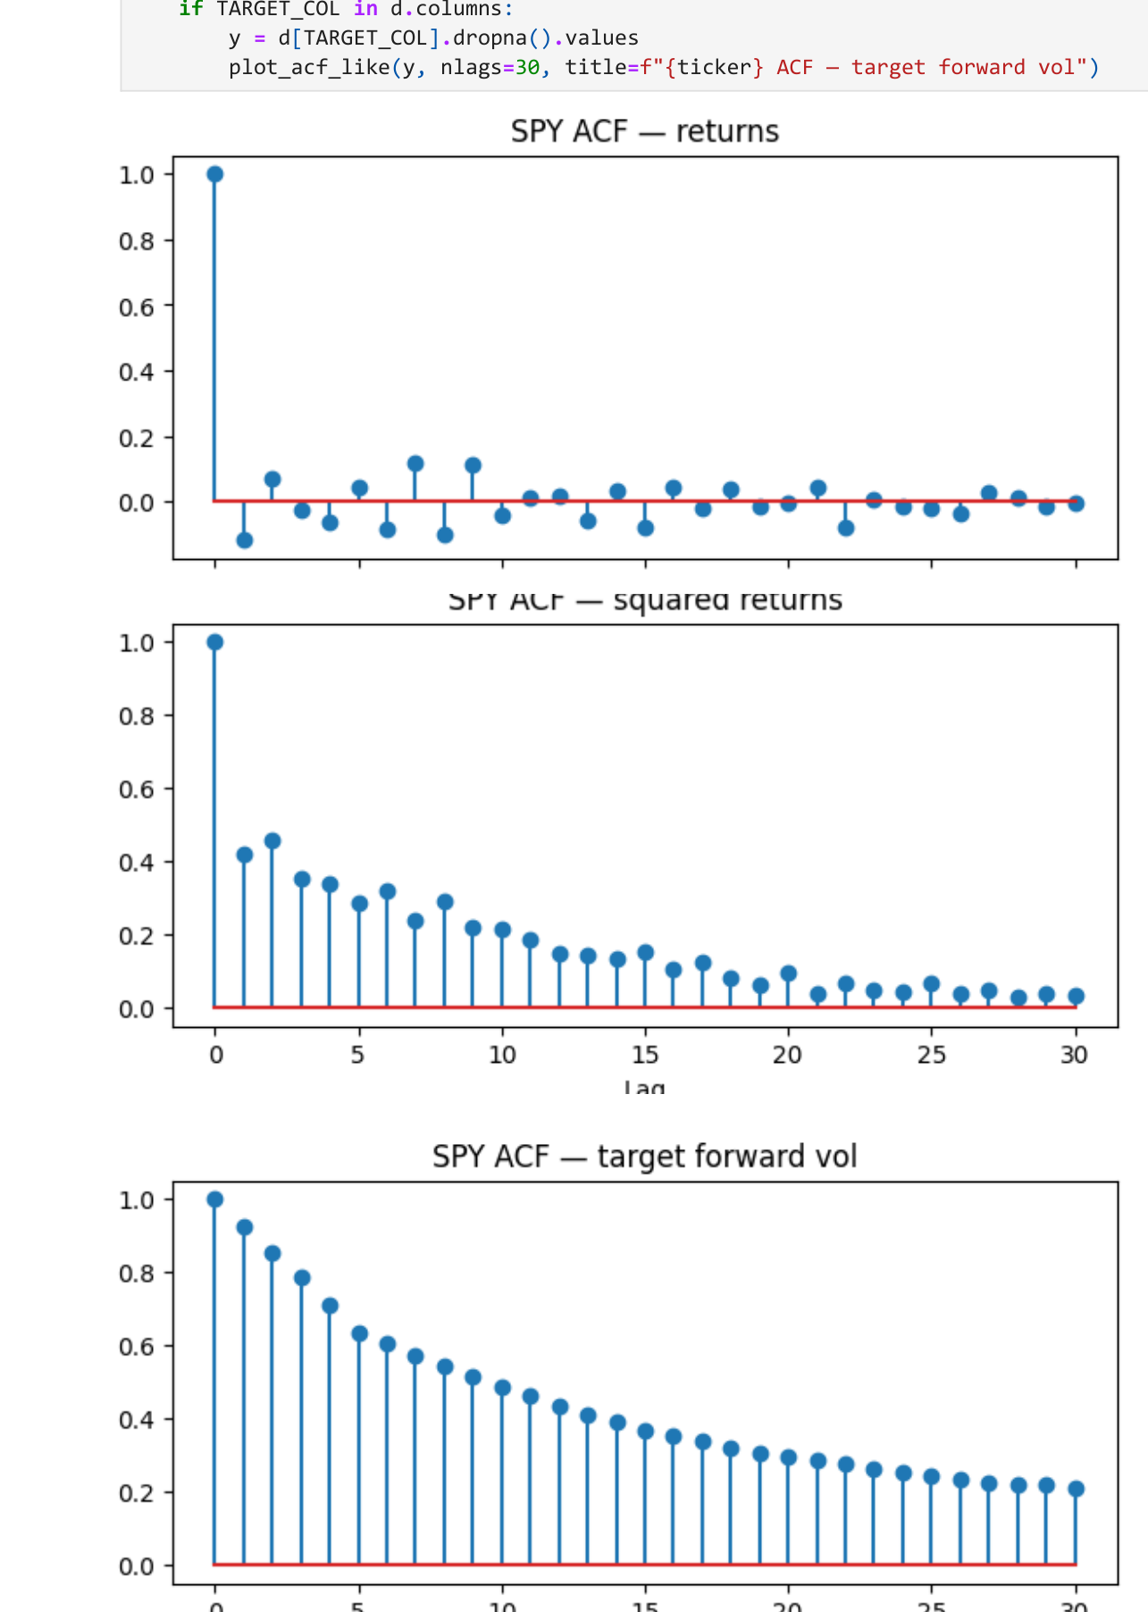
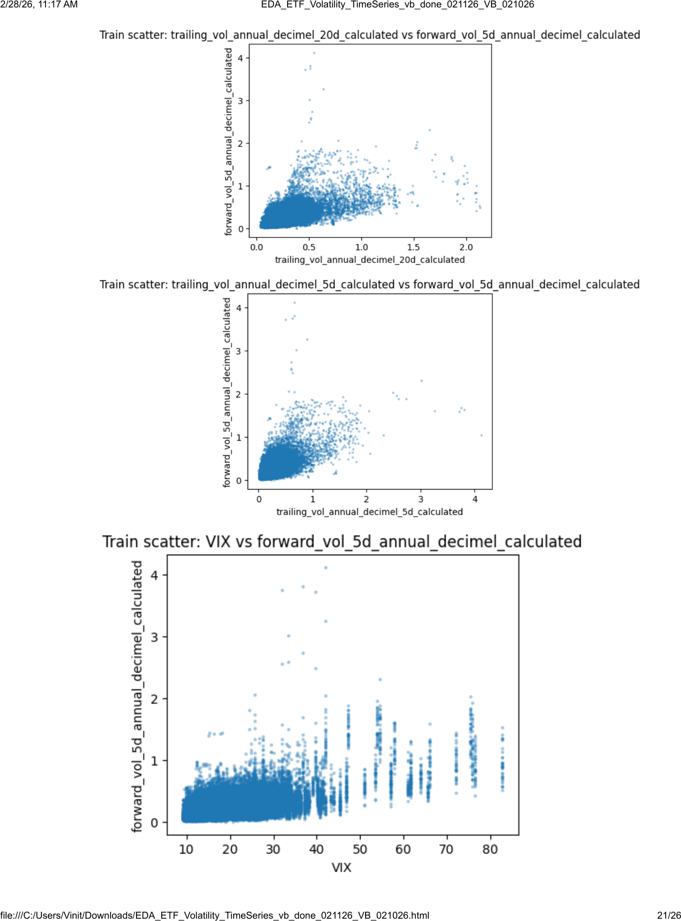
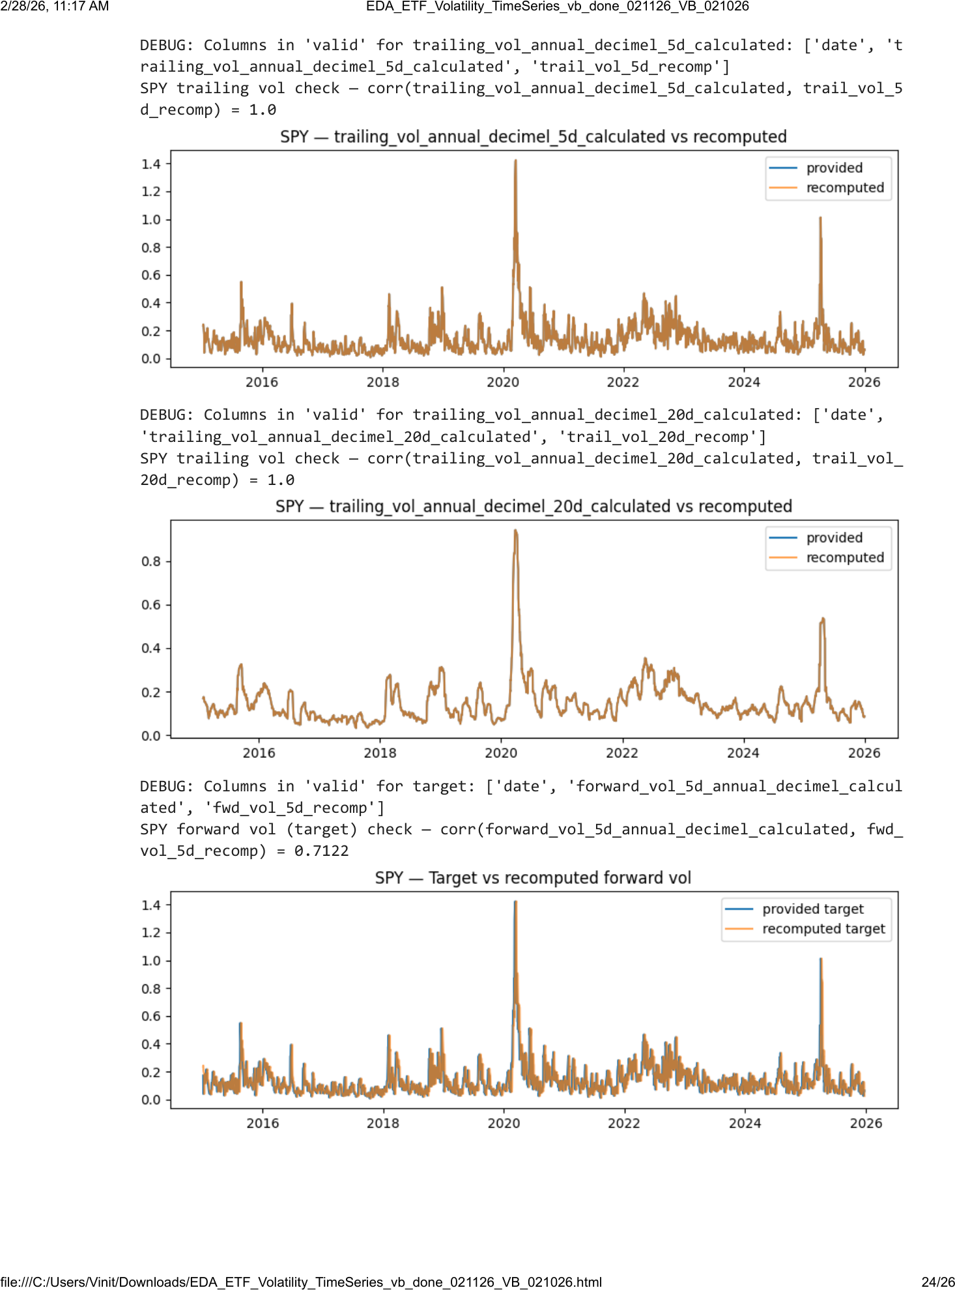
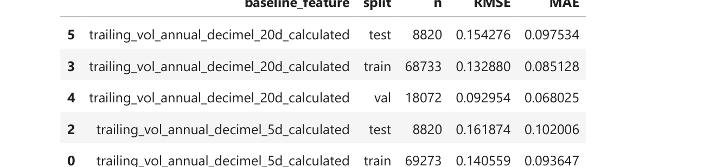
EDA (Vinit can add some things here but needs to simplify)
EDA Tests
Outputs & Plots
All EDA tests/checks performed
Representative plots produced by the notebook
1) Load + robust date parse + canonical (ticker, date) sort
2) Panel integrity: duplicate key check; per-ticker monotone dates
3) Coverage: per-ticker start/end and n_days table
4) Gaps: flag calendar gaps > 10 days within ticker
5) Missingness: by-column rates + target missingness by ticker
6) Macro sanity: macro columns constant across tickers per date (nunique)
7) Distribution EDA: returns, log(volume), trailing vol (calc + FactSet), target
8) Single-ticker series: price, returns, trailing vol, target + macro overlays
9) ACF diagnostics: returns vs squared returns vs target forward vol
10) Feature–target checks: train-only corr table + scatter plots
11) Leakage/alignment: recompute returns, trailing vol, forward vol; compare
12) Baselines: persistence using trailing 5d/20d vol (RMSE/MAE on train/val/test)
13) Save artifacts: coverage/missingness/macro-check tables to disk
Data quality
Coverage by ticker
Gaps & missingness
Macro constancy check
Time-series structure
Pooled distributions (returns/volume/vol)
Single-ticker
ACF diagnostics returns, sq. returns,
Signal, leakage checks, baselines
Feature–target relationships (corr + scatter)
Leakage/alignment checks
Baselines to beat
DATASCI 207 · Final Project: Forecasting Volatility In Stock Market · March 2026
Notes:
[Sources] - Uploaded PDF: DATASCI 207 — ETF Volatility Dataset: Time-Series EDA (EDA_ETF_Volatility_TimeSeries_vb_done_021126_VB_021026) — used for the checklist text and plot thumbnails. - Uploaded PPTX: project slide deck (style reference for header/footer and typography). [/Sources]

Slide 5
Forecasting Volatility In Stock Market
Project Scope
Our Objective:
Predict next-week (next 5 trading days) realized volatility using 36 S&P 500-linked ETFs using only information known at the prediction date.
Why it matters: volatility drives position sizing, risk budgeting, drawdown control, and derivatives/risk-management pricing.
Our Data:
Downloads from FactSet.
6 macro/risk series for regime context:
3 month T-Bill yield
10 year US bond yield
US 10 year - month yield spread
Gold spot price
Oil spot price
VIX
Market (1): SPY
Sector (13): IYZ, VGT, XLB, XLC, XLE, XLF, XLI, XLK, XLP, XLRE, XLU, XLV, XLY
Industry (22): BEDZ, FTXG, KBE, KCE, KIE, KRE, PEJ, PNQI, PXQ, XAR, XBI, XES, XHB, XHE, XHS, XME, XOP, XPH, XSD, XSW, XTL, XTN
Date range: 2014-12-31 to 2025-12-31
Our Models:
Transformer 1: Diogo
Transformer 2: Ronald
LSTM: Sid
Elastic Net Regression: Vinit
6 Baseline Models to compare to
DATASCI 207 · Final Project: Forecasting Volatility In Stock Market · March 2026
Notes:
Project description summarized from the team project proposal and milestone report. [Sources] - Project Proposal PDF (uploaded in this chat) - Project Milestone Report PDF (uploaded in this chat) [/Sources]

Slide 6
Elastic Net Regression
DS 207 Final Project · Team: Greed and Fear · Author: Vinit Bhatt · March 27, 2026

Slide 7
What Is Elastic Net?
How It Works
Elastic Net is a linear regression model with built-in regularization. It helps the model fit the data while avoiding noisy or unstable coefficients.
Think of it as a combination of two ideas:
Lasso (L1): removes weak or redundant features
Ridge (L2): shrinks and stabilizes correlated features
Elastic Net: does both at the same time
Why We Use It Here
Our volatility features overlap
Some macro variables may add little value
We want a model that is still easy to interpret
Bottom Line
Elastic Net is a strong, interpretable benchmark that helps us identify which features matter and which do not.
Main Tradeoff
Elastic Net is transparent and disciplined
But it is still linear, so it may miss nonlinear volatility patterns
DATASCI 207 · Final Project: Forecasting Volatility In Stock Market · March 2026

Slide 8
Interpretation: What Elastic Net Retained (We should get rid of V1)
V1 retains two current-state volatility features.
20-day trailing volatility term is the stronger predictor.
V2 adds six macro and market features.
Only VIX is retained; the others are shrunk to zero.
V1 retained features (2/2)
V2 retained features (3/8)
Feature
Coeff
Meaning
Feature
Coeff
Meaning
20-day trailing vol
+0.0487
Dominant, smoother persistence signal
20-day trailing vol
+0.0405
Still dominant; slightly smaller with VIX added
Current vol
+0.0377
Recency beyond the 20-day average
Current vol
+0.0323
Recency remains informative
VIX
+0.0293
Forward-looking implied volatility signal
V1 Economic Meaning: Volatility
Both coefficients are positive
20-day trailing volatility is the stronger signal
Current volatility recency
V2: Why VIX Survives
VIX forward-looking, while the other retained volatility measures are backward-looking.
That gives VIX unique predictive value in V2.
DATASCI 207 · Final Project: Forecasting Volatility In Stock Market · March 2026
Notes:
Coefficient interpretation for V1 and V2 (Elastic Net). [Sources] - elastic_net_vol_v1v2_vb_done_032726.ipynb (user-provided notebook) - elastic_net_vol_slides_wip_032726.pptx (user-provided deck)

Slide 9
Conclusions
Key Conclusions
V1 showed that current-state volatility features carry real predictive signal.
V2 improved on V1 modestly, and most of that improvement came from VIX.
V2 was the best Elastic Net model, but XGBoost remained the strongest benchmark on test MAE.
All retained coefficients were positive, consistent with volatility clustering and persistence.
Overall, Elastic Net provided a transparent and interpretable benchmark for the project.
DATASCI 207 · Final Project: Forecasting Volatility In Stock Market · March 2026

Slide 10
Long Short-Term Memory (LSTM)
DS 207 Final Project · Team: Greed and Fear · Author: Sid Sridhar · March 27, 2026

Slide 11
What Is LSTM?
How It Works
Type of recurrent neural network
Learns long-term dependencies
Keeps memory
Uses forget, input, and output
Keeps context relevant over time
Flexible learner
Works well with sequential data
time series forecasting
Memory cell tracks the volatility over the past few days
Like a moving average
Good for volatility tracking
Time dependent
Why We Use It Here
LSTM sees short term dynamics in feature window
Adds memory without lag/moving average columns
Each is its own feature
Harder to interpret compared to other models
No set coefficient table
Can overfit easily when labels are noisy
Training is very fragile
Elastic Net is clearer and more regular for example
Bottom Line
Main Tradeoff
DATASCI 207 · Final Project: Forecasting Volatility In Stock Market · March 2026

Slide 12
Transformer
DS 207 Final Project · Team: Greed and Fear · Author: Ronald Ho · March 27, 2026

Slide 13
What Are Transformers?
How It Works
Transformers are state-of-the-art deep learning models that utilize an “Attention Head” to analyze data sequentially (in time steps).
Each head can memorize patterns in the data in parallel, allowing us to map complex relationships.
The architecture is extremely complex, leading to many Hyper-Parameter considerations (# of heads, # of encoding blocks, dropout regularization)
Why We Use It Here
Temporal Fusion Transformers (TFT) have become increasingly popular as an area of research for modeling time series data.
In theory, the attention layer of the transformer should be ideal to model highly complex data patterns over time steps.
Bottom Line
A burgeoning field of research that is interesting to keep an eye on, because theoretically it could work very well.
With a more complex dataset (more data, a lot more features), this model might shine.
Main Tradeoff
This model is too complex for our data as it exists today.
We can only use a small amount of attention heads and encoder blocks before there’s a high degradation in RMSE, with the model trying to memorize patterns that don’t exist.
It is also slow and requires a lot of epochs to perform well.
DATASCI 207 · Final Project: Forecasting Volatility In Stock Market · March 2026
Notes:
Building a transformer requires a lot of specific choices to optimize the hyperparameters in the architecture. Due to its high memorization ability, we should keep the number of encoder blocks simple, approximately 2 to 4. Any more than that and we see a large amount of overfitting. This is paired with the Dropout (or Mask Padding in Ronald’s model), making our model ignore random weights in order to force the model to generalize well, not just memorize all of the data it sees.
Within the Encoder, we must make decisions on the Sequence length, Head Size, and the Feed Forward dimension. The Sequence Length determines how many days of history we look at (since one of our V2 variables looks at the past 20 days, I set this length to 21). Choosing Epochs is tricky: Transformers learn slowly but are also extremely consuming per epoch to calculate. We have to set a high epoch limit and let them train over a lengthened period of time, and rely on Early Stopping to check when our performance plateaus.

Slide 14
Transformer Architecture
Input
Input
Dropout
Multi-Head Attention
Transformer Encoding Block
Dropout
(…) * num_blocks
Layer Normalization
Transformer Encoding Block
Residual Connection
Flatten
Output (Dense)
Dropout
Dropout
Residual Connection
Output (Dense)
Layer Normalization
DATASCI 207 · Final Project: Forecasting Volatility In Stock Market · March 2026

Slide 15
Model Comparisons — 2025 Test Set (8,820 rows)
All results use the same 8,820-row test set. Lower MAE and RMSE are better; higher R² is better.
Model / Baseline | Test MAE | Test RMSE | Test R² | vs XGBoost
Elastic Net — V1 | 0.0855 | 0.1357 | 0.1794 | +0.0032
Elastic Net — V2 | 0.0846 | 0.1324 | 0.2188 | +0.0024
LSTM— V1 | 0.0949 | 0.0289 | -0.2690 | +0.0126
LSTM— V2 | 0.0509 | 0.00579 | 0.7418 | -0.0314 ★
Transformer-Encoder Only— V1 | 0.0889 | 0.1491 | 0.0212 | +0.066
Transformer-Encoder Only— V2 | 0.1056 | 0.1565 | -0.078780 | +0.0232
Transformer-Encoder (Diogo) – V1
Transformer-Encoder (Diogo) – V2 | 0.1034 | 0.1503 | 0.0425 | +0.0211
Baseline: XGBoost walk-forward | 0.0823 | 0.1352 | 0.1856 | BEST ★
Baseline: Trailing 20 Day Average | 0.0922 | 0.1491 | 0.0088 | +0.0099
Baseline: Trailing 5 Day Average | 0.1005 | 0.1625 | −0.1773 | +0.0182
Baseline: Current Volatility | 0.1020 | 0.1619 | −0.1680 | +0.0197
Baseline: Trailing 20 Day OLS | 0.1298 | 0.2091 | −0.9498 | +0.0475
Baseline: Trailing 5 Day OLS | 0.1644 | 0.2478 | −1.7383 | +0.0821
DATASCI 207 · Final Project: Forecasting Volatility In Stock Market · March 2026

Slide 16

THANK YOU!
DATASCI 207 · Final Project: Forecasting Volatility In Stock Market · March 2026

Slide 17
Elastic Net Setup: V1 vs. V2 ( I think we should get rid of V1)
V2 tests whether macro and market context improves on the simple volatility-only V1 model
Model Tier | Features | Count | Role / Notes
V1 — Current-State Volatility | Current realized volatility (most recent observation) 20-day trailing realized volatility | 2 | Pure vol-persistence model. Both features genuinely retained by Lasso.
V2 — Added Macro/Market | + Volume + NYGOLDS + OIL_WTI_S + US_10Y_BOND_YLD + US_3M_TB_YLD + VIX | 8 | Current-state macro context. Only VIX survives Lasso regularization. Other 5 macro features zeroed out.
DATASCI 207 · Final Project: Forecasting Volatility In Stock Market · March 2026

